Slide 1
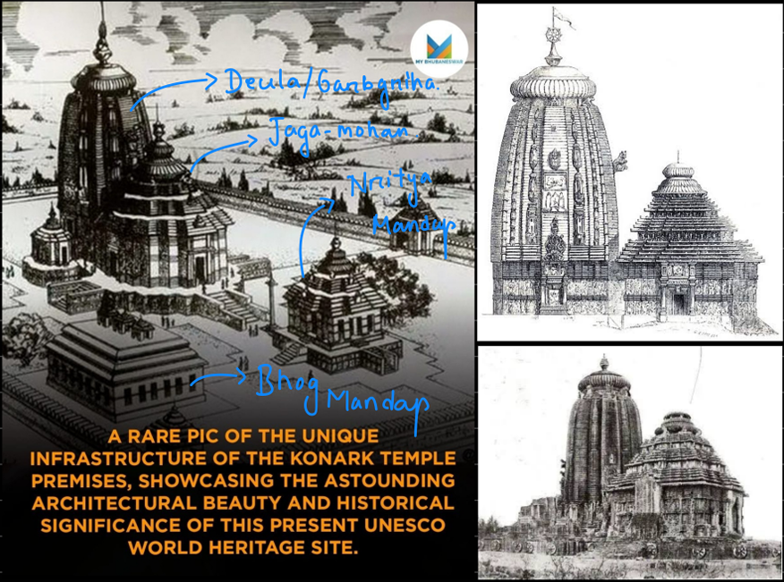
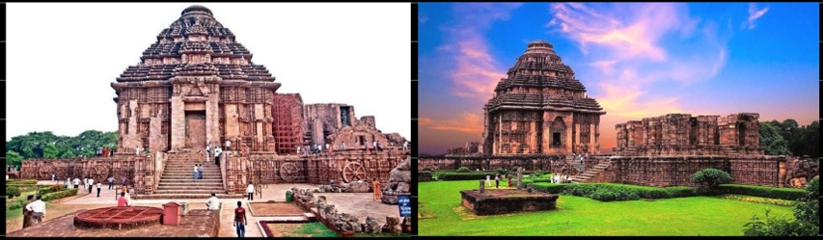
Shreenandan Sahu | CL24M013
K S Suraksha Jain | CL24M015

Slide 2
Project Objectives:
Virtually reconstruct the lost parts of the Konark Sun Temple using VR.
Provide an immersive, educational experience for cultural preservation and tourism.
Develop a user-friendly platform to help tourists and students understand the architecture and history

Slide 3
Methodology
3D Modelling and VR Development: Sketchup for model and unity for VR.
Interaction in VR: Implement user interactions, such as Time-based Gazes and Twister mechanisms.

Slide 4
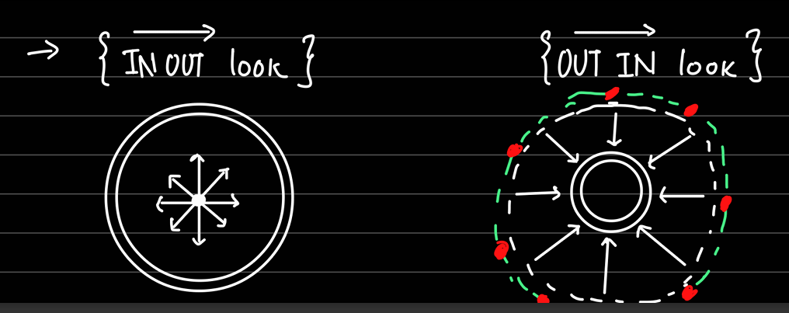
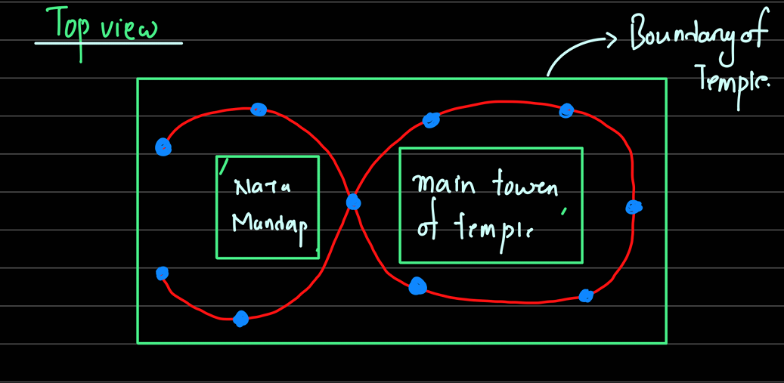
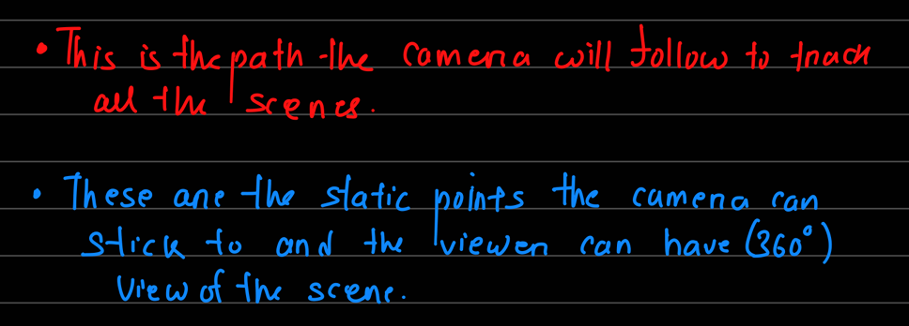

Slide 5
VR Concepts:
Immersion: User will be able to fully immerse into the Virtual World through Audio Visuals.
Rendering: The 3D model will be rendered along with the textures, artificial sunlight (tracking time using shadow)
Position Tracking: Position Tracking using the Cardboard SDK .
Gaze Timing: Time tracking based interaction with the environment
Head Orientation Tracking: Tracing the head twist to cause locomotion

Slide 6
Timeline
Phase 1: Research and data collection (1 Week)
Phase 2: 3D modelling and prototype development (2 Weeks)
Phase 3: Unity Environment, textures, and lighting (2 Weeks)
Phase 4: Refinements and final deployment (2 Weeks)
Total project duration: Approximately 1.5 months

Slide 7
